Slide 1
Machine Learning Introduction
Haibin Yuan / GS HCM
April 01, 2016

Slide 2
Definition
"The field of study that gives computers the ability to learn without being explicitly programmed." - Arthur Samuel (1959)
"A computer program is said to learn from experience E with respect to some class of tasks T and performance measure P, if its performance at tasks in T, as measured by P, improves with experience E." - Tom Mitchell (1997)
Notes:
Example: AlphaGo.
E = the experience of playing many games of checkers. E.g. the way human was playing the game
T = the task of playing checkers. E.g. be a good robot player
P = the probability that the program will win the next game. E.g. win all the games against human
“对于某类任务T和性能度量P，如果一个计算机程序在T上以P衡量的性能随着经验E而自我完善，那么我们称这个计算机程序在从经验E学习。”

Slide 3
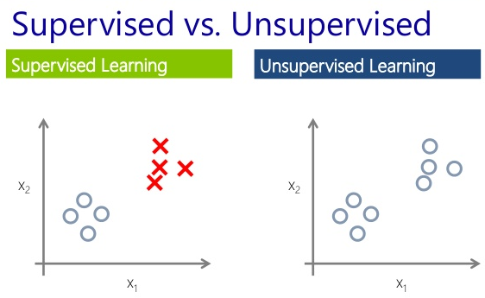
Classifications of Machine Learning Problems
Supervised Learning: we are given a data set and already know what our correct output should look like
Regression Problem our goal is to predict a continuous valued output
Classification Problem our goal is to predict a discrete value output
Unsupervised Learning have no idea what our results should look like
Clustering
Non-Clustering
Semi-Supervised Learning
Notes:
Supervised: You teach your kids to do something
Unsupervised: Your kids do something based on their own understanding; NLA,
(Supervised - With Input and Target; Unsupervised – Input Only)
Regression Example: Predict Age by Picture
Classification Example: Bank Loan based on Personal Credit
Clustering(聚类) Example: Put similar or related data into a group by variables, e.g. Google News
Non-Clustering Example: Find Structure in Messy Data - Cocktail Party Algorithm; or NLA
Note: Regression & Classification can turn into each other by change the question, e.g. House Price, ask “can sell more or less than expected price”

Slide 4
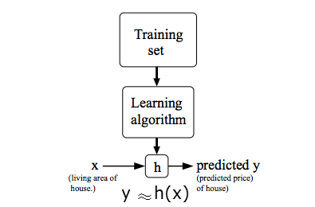
Model Representation
Supervised Learning: hypothesis function: h(x) is a “good” predictor for the corresponding value of y.
Parametric Algorithm
Linear Algorithm: (fixed pattern) y = a + b*x
Training Set: (fixed value)
x = 1; y = 1.7 …
Parameter Groups: (decided by program) a = 1.5; b = 0.2 a = 1.4; b = 0.3 … Question: How can a program know which group is better?
Non-Parametric Algorithm

Slide 5


Cost Function
Definition: to measure the accuracy of our hypothesis function. (to minimize the difference between the predicted value and actual value)
Example: Model Algorithm: Cost Function:
How To Resolve Cost Function? e.g LMS(Least Mean Square) algorithms (Gradient Descent algorithms)
Notes:
代价函数
Find seta 1 and seta 2 which lead to the minimal cost

Slide 6
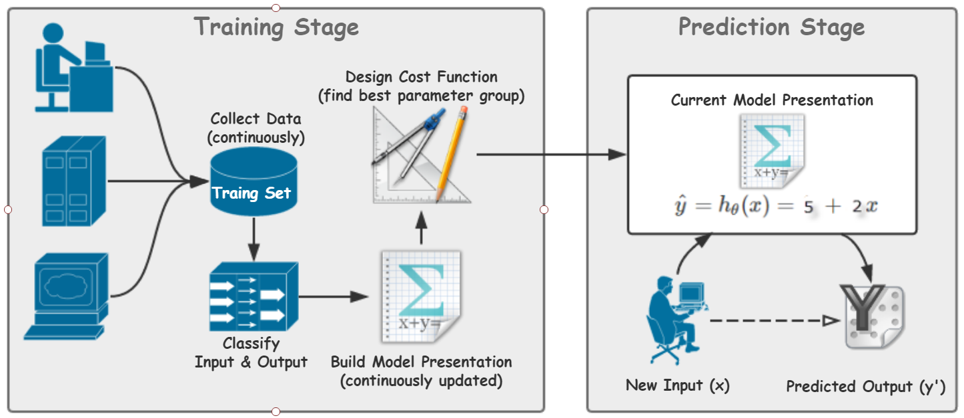
Workflow Example
Notes:
the parameters of math model need to will be updated as the training set is continuously growing
add verification & evolution stage if necessary, evolution means the whole model is changed, e.g. from single parameter regression to multiple parameter regression.

Slide 7
Demo
https://github.wdf.sap.corp/i075908/ml-linear-regression-demo

Slide 8
To Be Continued …
Unsupervised Learning
Linear Regression with Multiple Variables (参数算法)
Logistic Regression & Regularization (非参数算法)
Neural Networks (神经网络)
‘black box’ learning algorithm – SVM (支持向量机)
Unsupervised Learning
Dimensionality Reduction (降维)
…
Ref: Machine Learning by Stanford University https://www.coursera.org/learn/machine-learning/home/welcome Important: Week 6 - Advice for Applying Machine Learning

Slide 9
Thank You!
I075908
Haibin Yuan

